Slide 1
M5

Slide 2
3. Cropping patterns :
Different ways of growing crops used to give maximum benefit.
There are different ways of cropping patterns :

Slide 3
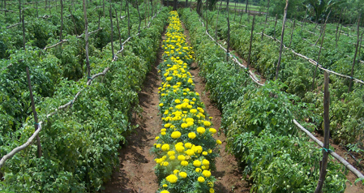
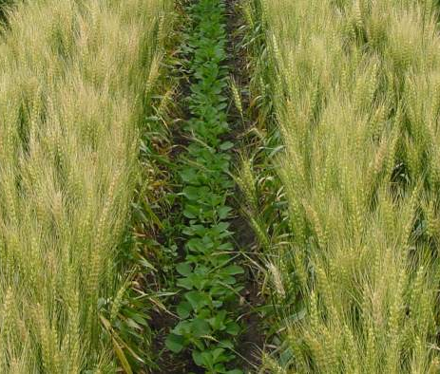
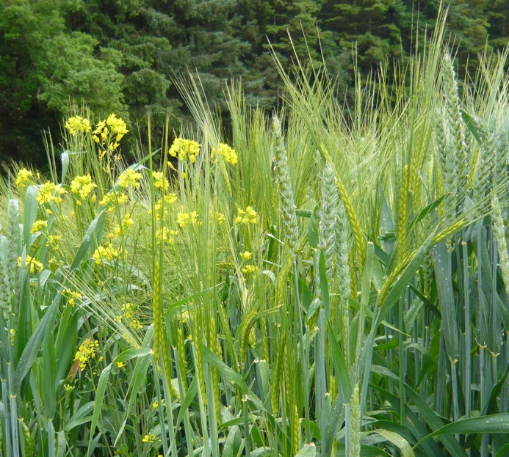
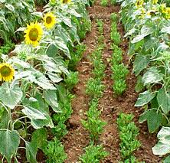
Mixed cropping :
Mixed cropping is growing two or more crops simultaneously on the same piece of land.
For example,
wheat + gram,
or wheat + mustard
or groundnut + sunflower.
This reduces risk and gives some insurance against failure of one of the crops.

Slide 4
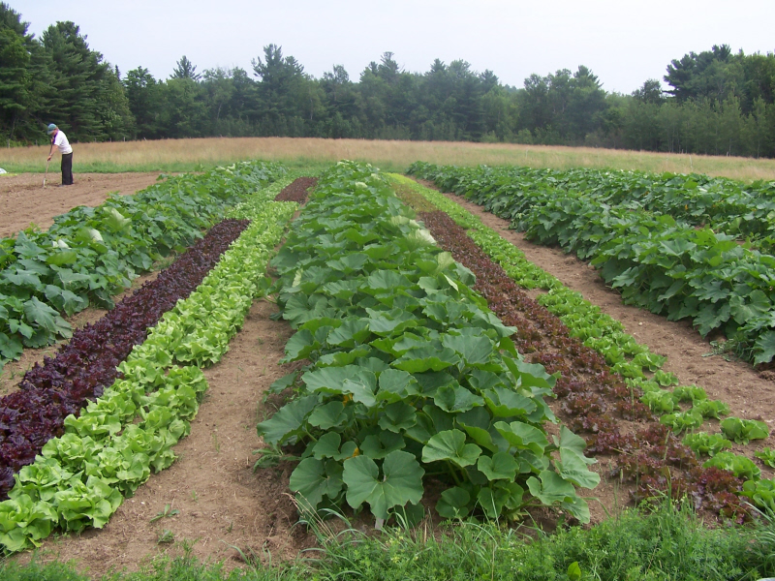
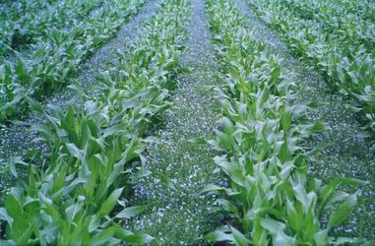
Inter-cropping :
Inter-cropping is growing two or more crops simultaneously on the same field in a definite pattern.
A few rows of one crop alternate with a few rows of a second crop
For example,
soyabean + maize
or Finger millet (bajra) + cowpea
(lobia)
The crops are selected such that their nutrient requirements are different.
This ensures maximum utilisation of the nutrients supplied, and also prevents pests and diseases from spreading to all the plants belonging to one crop in a field.
This way, both crops can give better returns.

Slide 5
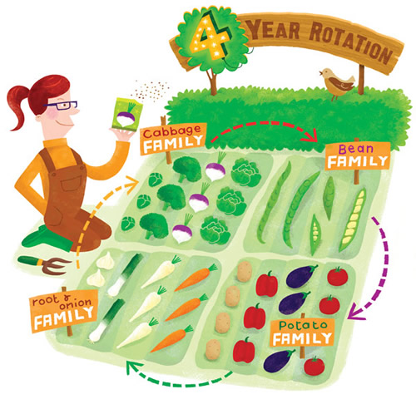
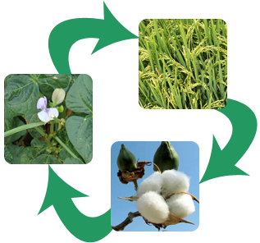
Crop rotation :
The growing of different crops on a piece of land in a pre-planned succession is known as crop rotation.
Depending upon the duration, crop rotation is done for different crop combinations.
The availability of moisture and irrigation facilities decide the choice of the crop to be cultivated after one harvest.
If crop rotation is done properly then two or three crops can be grown in a year with good harvests.

